Slide 1
Chapter – 3 unit testing

Slide 2
Outline of the Chapter
Concept of Unit Testing
Static Unit Testing
Defect Prevention
Dynamic Unit Testing
Mutation Testing
Debugging
Unit Testing in eXtreme Programming
Tools For Unit Testing

Slide 3
Concept of Unit Testing
Static Unit Testing
Code is examined over all possible behaviors that might arise during run time
Code of each unit is validated against requirements of the unit by reviewing the code
Dynamic Unit Testing
A program unit is actually executed and its outcomes are observed
One observe some representative program behavior, and reach conclusion about the quality of the system
Static unit testing is not an alternative to dynamic unit testing
Static and Dynamic analysis are complementary in nature
In practice, partial dynamic unit testing is performed concurrently with static unit testing
It is recommended that static unit testing be performed prior to the dynamic unit testing

Slide 4
Static Unit Testing
In static unit testing code is reviewed by applying techniques:
Inspection: It is a step by step peer group review of a work product, with each step checked against pre-determined criteria
Walkthrough: It is review where the author leads the team through a manual or simulated executed of the product using pre-defined scenarios
The idea here is to examine source code in detail in a systematic manner
The objective of code review is to review the code, and not to evaluate the author of the code
Code review must be planned and managed in a professional manner
The key to the success of code is to divide and conquer
An examiner inspect small parts of the unit in isolation
nothing is overlooked
the correctness of all examined parts of the module implies the correctness of the whole module

Slide 5
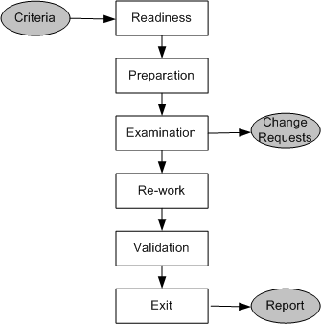
Static Unit Testing (Code Review)
Step 1: Readiness Criteria
Completeness
Minimal functionality
Readability
Complexity
Requirements and design documents
Roles
Moderator
Author
Presenter
Record keeper
Reviewers
Observer
Step 2: Preparation
List of questions
Potential Change Request (CR)
Suggested improvement opportunities
Figure 1: Steps in the code review process

Slide 6
Static Unit Testing (Code Review)
Step 3: Examination
The author makes a presentation
The presenter reads the code
The record keeper documents the CR
Moderator ensures the review is on track
Step 4: Re-work
Make the list of all the CRs
Make a list of improvements
Record the minutes meeting
Author works on the CRs to fix the issue
Step 5: Validation
CRs are independently validated
Exit
A summary report of the meeting minutes is distributed
A Change Request (CR) includes the following details:
Give a brief description of the issue
Assign a priority level (major or minor) to a CR
Assign a person to follow it up
Set a deadline for addressing a CR

Slide 7
Static Unit Testing (Code Review)
The following metrics can be collected from a code review:
The number of lines of code (LOC) reviewed per hour
The number of CRs generated per thousand lines of code (KLOC)
The number of CRs generated per hour
The total number of hours spend on code review process

Slide 8
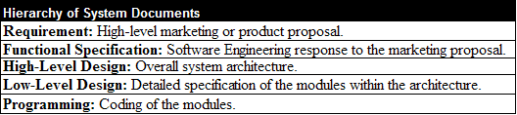
Static Unit Testing (Code Review)
The code review methodology can be applicable to review other documents
Five different types of system documents are generated by engineering department
Requirement
Functional Specification
High-level Design
Low-level Design
Code
In addition, installation, user, and troubleshooting guides are developed by the technical documentation group
Table 1: System documents

Slide 9
Defect Prevention
Build instrumentation code into the code
Use standard control to detect possible occurrences of error conditions
Ensure that code exists for all return values
Ensure that counter data fields and buffer overflow/underflow is appropriately handled
Provide error messages and help texts
Validate input data, such as arguments, passed to a function
Use assertions to detect impossible conditions
Leave assertions in the code (activate/deactivate)
Fully document the assertions that appear to be unclear
After every major computation, reverse-compute the input(s) from the results in the code itself
Develop a timer routine
Include a loop counter within each loop

Slide 10
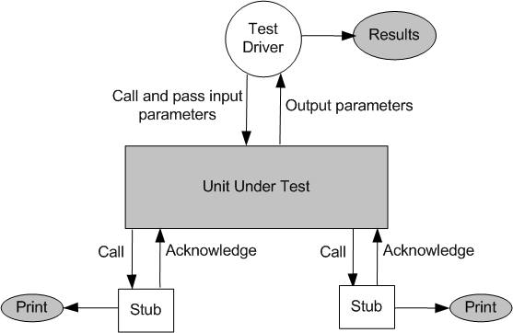
Dynamic Unit Testing
The environment of a unit is emulated and tested in isolation
The caller unit is known as test driver
A test driver is a program that invokes the unit under test (UUT)
It provides input data to unit under test and report the test result
The emulation of the units called by the UUT are called stubs
It is a dummy program
The test driver and the stubs are together called scaffolding
The low-level design document provides guidance for selection of input test data
Figure 2: Dynamic unit test environment

Slide 11
Dynamic Unit Testing
Selection of test data is broadly based on the following techniques:
Control flow testing [Chapter 4]
Draw a control flow graph (CFG) from a program unit
Select a few control flow testing criteria
Identify a path in the CFG to satisfy the selection criteria
Derive the path predicate expression from the selection paths
By solving the path predicate expression for a path, one can generate the data
Data flow testing [Chapter 5]
Draw a data flow graph (DFG) from a program unit and then follow the procedure described in control flow testing.
Domain testing [Chapter 6]
Domain errors are defined and then test data are selected to catch those faults
Functional program testing [Chapter 9]
Input/output domains are defined to compute the input values that will cause the unit to produce expected output values

Slide 12
Mutation Testing
Mutation testing, also known as code mutation testing, is a form of white box testing in which testers change specific components of an application's source code to ensure a software test suite will be able to detect the changes.
Changes introduced to the software are intended to cause errors in the program.
Modify a program by introducing a single small change to the code
A modified program is called mutant
A mutant is said to be killed when the execution of test case cause it to fail. The mutant is considered to be dead
A mutant is an equivalent to the given program if it always produce the same output as the original program
A mutant is called killable or stubborn, if the existing set of test cases is insufficient to kill it
A mutation score for a set of test cases is the percentage of non-equivalent mutants killed by the test suite
The test suite is said to be mutation-adequate if its mutation score is 100%

Slide 13
Mutation testing
Equivalent Mutant: A mutant is equivalent if no test case can distinguish it from the original program. It always produces the same output as the original program for all possible inputs.
Killed Mutant: A mutant is killed if the output from the mutant program differs from the output of the original program for at least one test case.
Killable Mutant: A mutant is killable if, with the current set of test cases, it produces the same output as the original program (thus not killed), but it is possible that some other test case could produce a different output, thereby killing the mutant.

Slide 14
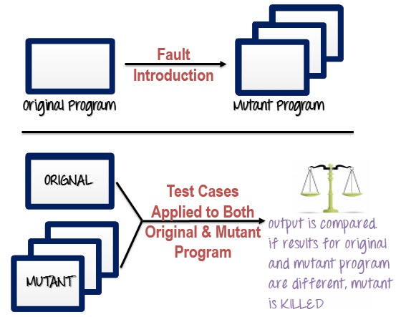
Mutation testing

Slide 15
Mutation testing
Consider the following program P
1 main(argc,argv)
2 int argc, r, i;
3 char *argv[];
4 { r = 1;
5 for i = 2 to 3 do
6 if (atoi(argv[i]) > atoi(argv[r])) r = i;
7 printf(“Value of the rank is %d \n”, r);
8 exit(0); }
Test Case 1:
input: 1 2 3
output: Value of the rank is 3
Test Case 2:
input: 1 2 1
output: Values of the rank is 2
Test Case 3:
input: 3 1 2
output: Value of the rank is 1
Mutant 1: Change line 5 to for i = 1 to 3 do
Mutant 2: Change line 6 to if (i > atoi(argv[r])) r = i;
Mutant 3: Change line 6 to if (atoi(argv[i]) >= atoi(argv[r])) r = i;
Mutant 4: Change line 6 to if (atoi(argv[r]) > atoi(argv[r])) r = i;
Execute modified programs against the test suite, you will get the results:
Mutants 1 & 3: Programs will pass the test suite, i.e., mutants 1 & 3 are not killable
Mutant 2: Program will fail test cases 2
Mutant 1: Program will fail test case 1 and test cases 2
Mutation score is 50%, assuming mutants 1 & 3 non-equivalent

Slide 16
Mutation testing
The score is found to be low because we assumed mutants 1 & 3 are nonequivalent
We need to show that mutants 1 and 3 are equivalent mutants or those are killable
To show that those are killable, we need to add new test cases to kill these two mutants
First, let us analyze mutant 1 in order to derive a “killer” test. The difference between P and mutant 1 is the starting point
Mutant 1 starts with i = 1, whereas P starts with i = 2. There is no impact on the result r. Therefore, we conclude that mutant 1 is an equivalent mutant
Second, if we add a fourth test case as follows:
Test Case 4:
input: 2 2 1
Program P will produce the output “Value of the rank is 1” and mutant 3 will produce the output “Value of the rank is 2”
Thus, this test data kills mutant 3, which give us a mutation score 100%

Slide 17
Mutation testing
Execute each test case in T against each mutant P_{i}. If the output of the mutant P_{i} differs from the output of the original program P, the mutant P_{i} is considered incorrect and is said to be killed by the test case.
If P_{i} produces exactly the same results as the original program P for the tests in T, then one of the following is true:
P and P_{i} are equivalent. What differentiates them from others is that they have the same meaning as the original source code, even though they may have different syntax. That is, their behaviors cannot be distinguished by any set of test cases. Note that the general problem of deciding whether or not a mutant is equivalent to the original program is undecidable.
P_{i} is killable. That is, the test cases are insufficient to kill the mutant P_{i}. In this case, new test cases must be created.

Slide 18
Mutation SCORE
The mutation score is defined as the percentage of killed mutants with the total number of mutants.
Mutation score = 100 × D/(N −E), where D is the dead mutants, N the total number of mutants, and E the number of equivalent mutants.
Test cases are mutation adequate if the score is 100%.
It is an effective approach for measuring the adequacy of the test cases.
Main drawback is high cost of generating the mutants and executing each test case against that mutant program.
Tools come in handy to speed up the process of mutant generation. Some tools that can be used for mutation testing: Stryker, Jumble, PIT, and Insure++.

Slide 19
Mutation testing types
Value Mutation
Here, we introduce a mutation by changing the parameter and/or constant values, usually by +/- 1.
If the above code was meant to multiply the even numbers where i<4, then value mutation would mean changing the initialization to let i=1.
let arr = [2,3,4,5]
for(let i=0; i<arr.length; i++)
{
if(i%2===0)
{
console.log(i*2)
}
}
let arr = [2,3,4,5]
for(let i=1; i<arr.length; i++)
{
if(i%2===0)
{
console.log(i*2)
}
}
Original Code
Mutant Code

Slide 20
Mutation testing types
Statement Mutation
Here, we delete or duplicate a statement in a code block. We could also rearrange statements in a code block.
In an if-else block, for example, we could delete the else part or even the entire if-else block.
let arr = [2,3,4,5]
for(let i=0; i<arr.length; i++)
{
if(i%2===0)
{
console.log(i*2)
}
}
let arr = [2,3,4,5]
for(let i=0; i<arr.length; i++)
{
if(i%2===0)
{
console.log(i*2)
console.log(i*2)
}
}
Original Code
Mutant Code

Slide 21
Mutation testing types
Decision Mutation
The target here is the code that makes decisions, for example, value comparisons.
Other operators that we can switch include the following:
 | Original Operator | Mutant Operator
1 | <= | >=
2 | >= | ==
3 | === | ==
4 | and | or
5 | || | &&

Slide 22
Numerical Example
A test engineer generates 70 mutants of a program P and 150 test cases to test the program P. After the first iteration of mutation testing, the tester finds 58 dead mutants and 4 equivalent mutants. Calculate the mutation score for this test suite. Is the test suite adequate for program P? Should the test engineer develop additional test cases? Justify your answer.
solution
Mutation Score = 100 D/(N − E), where D = number of dead mutants = 58, N = total number of mutants = 70, and E = number of equivalent mutants = 4.
Therefore, mutation score = 100 x 58/66 = 87%.
The test suite is not adequate, because the mutation score is not 100%.
There are 8 mutants that are killable. The tester needs to develop additional test cases to kill these eight mutants in order to achieve 100% mutation score.

Slide 23
Debugging
The process of determining the cause of a failure is known as debugging
It is a time consuming and error-prone process
Debugging involves a combination of systematic evaluation, intuition and a little bit of luck
The purpose is to isolate and determine its specific cause, given a symptom of a problem
There are three approaches to debugging
Brute force
Cause elimination
Backtracking

Slide 24
Debugging
Brute force method:
Print statements are inserted throughout the program to print the intermediate values with the hope that some of the printed values will help to identify the statement in error.
Backtracking:
Starting from the statement at which an error symptom has been observed, the source code is traced backwards until the error is discovered.
Cause elimination method:
Once a failure is observed, the symptoms of the failure are noted.
Based on the failure symptoms, the causes which could have contributed to the symptom is developed and tests are conducted to eliminate each.

Slide 25
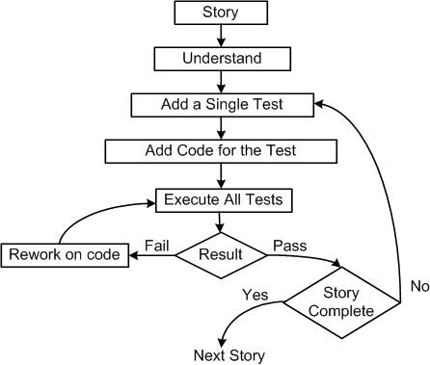
Unit Testing in eXtreme Programming
Pick a requirement, i.e., a story
Write a test case that will verify a small part of the story and assign a fail verdict to it
Write the code that implement particular part of the story to pass the test
Execute all test
Rework on the code, and test the code until all tests pass
Repeat step 2 to step 5 until the story is fully implemented
Figure 3: Test-first process in XP

Slide 26
Unit Testing in extreme Programming
Three laws of Test Driven development (TDD)
One may not write production code unless the first failing unit test is written
One may not write more of a unit test than is sufficient to fail
One may not write more production code than is sufficient to make the failing unit test pass
Pair programming:
In XP, code is being developed by two programmers working side by side
One person develops the code tactically and the other one inspects it methodically by keeping in mind the story they are implementing

Slide 27
Tools For Unit Testing
Code auditor
This tool is used to check the quality of the software to ensure that it meets some minimum coding standard
Bound checker
This tool can check for accidental writes into the instruction areas of memory, or to other memory location outside the data storage area of the application
Documenters
These tools read the source code and automatically generate descriptions and caller/callee tree diagram or data model from the source code
Interactive debuggers
These tools assist software developers in implementing different debugging techniques
Examples: Breakpoint and Omniscient debuggers
In-circuit emulators
It provides a high-speed Ethernet connection between a host debugger and a target microprocessor, enabling developers to perform source-level debugging

Slide 28
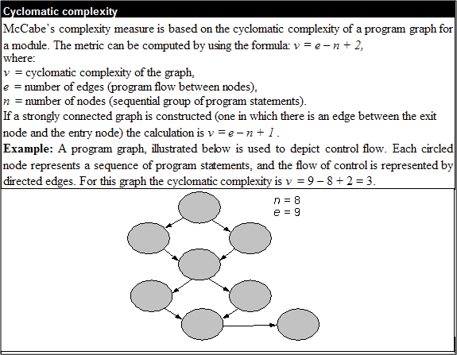
Tools for Unit Testing
Memory leak detectors
These tools test the allocation of memory to an application which request for memory and fail to de-allocate memory
Static code (path) analyzer
These tool identify paths to test based on the structure of code such as McCabe’s cyclomatic complexity measure
McCabe complexity measure

Slide 29
Tools for Unit Testing
Software inspection support
Tools can help schedule group inspection
Test coverage analyzer
These tools measure internal test coverage, often expressed in terms of control structure of the test object, and report the coverage metric
Test data generator
These tools assist programmers in selecting test data that cause program to behave in a desired manner
Test harness
This class of tools support the execution of dynamic unit tests
Performance monitors
The timing characteristics of the software components be monitored and evaluate by these tools
Network analyzers
These tools have the ability to analyze the traffic and identify problem areas

Slide 30
Tools for Unit Testing
Simulators and emulators
These tools are used to replace the real software and hardware that are not currently available. Both the kinds of tools are used for training, safety, and economy purpose
Traffic generators
These produces streams of transactions or data packets.
Version control
A version control system provides functionalities to store a sequence of revisions of the software and associated information files under development

Slide 31
Thank You!!

